Slide 1
Evaluation, Form C, Reflective Essay, and Documenting your Accomplishments
Presented by:
Sonja Fritzsche, Associate Dean for Academic Personnel and Administration, College of Arts & Letters
fritzsc9@msu.edu sonjafritzsche.com
@sfritzsc

Slide 2
What? I’m being evaluated? When?!!
Don’t be this person!

Slide 3
Don’t wait! Get the parameters/facts
First month conversations with supervisor
Clarity of job description? Offer letter and Academic Specialist Job Description Form?
Additional Performance expectations?
Timeline? Annual and multi-year
Policies and procedures?: Academic Specialist Handbook/Unit Bylaws/Guidelines/ Supervisor? Committee?
Dossier materials? Form C?

Slide 4
Academic Specialist Job Description Form
Advising
Teaching
Curriculum Development
Public Service/Outreach
Research
Administrative Activities

Slide 5
Annual Evaluation and Promotional Process
One builds on the other
Materials gathered for one form basis of the next
Start tomorrow!
First annual review feedback basis for dossier for the first promotional review
Half-year check-in with yourself and goals

Slide 6
Self-narrative to self: Values
Draft statement to self - Your personal and professional values - These might or might not overlap with unit values.
Might be – respect, equity, trust, etc.
However, you with to express them to self

Slide 7
Self-narrative to self: Goals/Strategies
Based upon these values - your yearly goals - your strategies for attaining those goals
Yearly goals in job description
What and how – strategies
- Skills needed – workshops to attend
- Create a new syllabus – how to best gather material

Slide 8
Charting your Path to Intellectual Leadership (CPIL)
CPIL – Associate Deans Bill Hart-Davidson & Cara Cilano, Dean Chris Long, and myself
Stepping stones, milestones, horizon
Self-vision
Your own professional values and goals
Unit values, job duties and goals
Direction – way forward – 3-5 year self plan
to grow as an intellectual leader

Slide 9
Document, document, document!
Want to share statement with your supervisor?
Digital Folder with file: On demand or monthly documentation of activities and collection of materials
File away feedback e-mail, etc. save as PDF

Slide 10
Dossier
Form C
5-page self-assessment/reflective essay
Recent CV
Supporting materials
If second review, names for referees external to the unit

Slide 11
Criteria
From MSU Academic Specialist Handbook
Reappointment of the academic specialist, including the award of continuing appointment status and promotion to the rank of senior academic specialist, must be based on meritorious performance, not merely time spent in the position. The underlying premise is that individuals appointed as academic specialists are professionals dedicated to the performance of their responsibilities, the advancement of the University and maintaining Michigan State University as a premier land-grant, AAU University.
It is to be recognized that no one individual is to be required to perform or excel in all three functional areas.

Slide 12
Form C
Official form that guides and accompanies your promotion dossier
Standardized organization of the total of your professional accomplishment
Filled out by you and unit administrator
Can use as guide for your conversations with your administrator
https://www.hr.msu.edu/ua/hiring/documents/AcadSpecRecFormC_allpgsfill.pdf

Slide 13
Evaluation Expectations
Form C - Statement – provide summary of advising, teaching, curriculum development, research, public service/outreach
Definition - Effectiveness, innovation, professional contributions, leadership, commitment to and evidence of promoting an appropriate climate of diversity and intellectual honesty, summary of evidence of recognition, advancement of knowledge

Slide 14
Form C – Sections
Academic Advising
Teaching Activities
Non-credit instructional activities/presentations (past 3 years)
Curriculum planning and development
Publications
Grants
Research
Public Service/Outreach
Administrative Activities
Committee Service
Other professional service
Awards/honors
Letters of recommendation

Slide 15
Form C – Additional components
Internal/external review letters (depending on review) – solicited by supervisor
Summary evaluation by unit administrator and dean based on job description, unit evaluation criteria and expectations: significance, impact, context, scholarship/professional development/ accomplishments
Other supporting materials

Slide 16
Reflective Essay/Academic Specialist Summary Statements
Provide a detailed summary to your Unit Administrator,
Organized by job description
Citing evidence of distinction and sustained excellent performance, development over time/trajectory
Describe examples of best work

Slide 17
Materials - Teaching
SIRS Forms (course evaluations)
Any supplementary course evaluations
Syllabi
Representative best course materials
Distribution (100, 300, IAH/ISS/ISB/ISP)
Short intro paragraph about why innovative or reference in narrative to materials
Course observation letters
Select letters/e-mails/quotes from students

Slide 18
Materials – Curriculum Development
Syllabi
Best representations of range of work
Best representations of most important work
Reference in narrative as to why innovative and significant
Any letters of support
Not exhaustive – imagine if you were on the committee, what would you want to see to make your case? More quality than quantity
Other ideas?

Slide 19
Materials – Public Service/Outreach
Evidence of events planned
Metrics –
Collect data of touchpoints, meetings held, phone calls, new contacts, range, type, subject, etc. as you go.
Don’t assume you will remember!
Conversation with supervisor as to what
Other ideas?

Slide 20
Materials – Research/Professional development
Publication
Honors and awards
Workshops/trainings?
Conferences/presentations?
Activity-related publications/resources/ digital or analog
Other ideas?

Slide 21
Letters/Evidence of Success
Program Assessment
Student quotes
Student emails
Thank you notes (Students, committee members, conference presentations).
Letters of recommendations (students, colleagues, MSU community)
Presentation evaluations

Slide 22
Questions? Comments? Concerns?

Slide 23
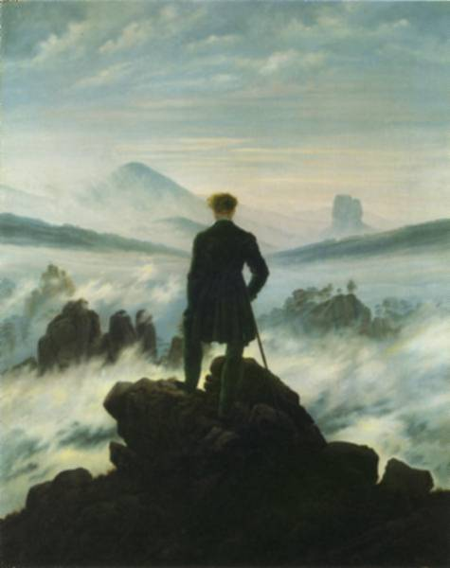
Caspar David Friedrich & the top (Wanderer above the Sea of Fog, 1818)

