Slide 1
Conversation with Interim Provost Teresa A. Sullivan and Executive Vice President for Health Sciences Norman Beauchamp
January 24, 2020

Slide 2
Today’s agenda
Lay of the land for this morning – Terry Sullivan
Provost Search Update – Beronda Montgomery and Ron Hendrick
Strategic Plan Overview – Joe Salem and Vennie Gore
Diversity, Equity, and Inclusion Plan Steering Committee Brief Overview – Cynthia Jackson-Elmoore and Luis Garcia
Health Sciences – Norm Beauchamp
Admissions, dean reviews and searches – Terry Sullivan
Q&A, via microphone or with card option of anonymity

Slide 3
Provost Search Update

Slide 4
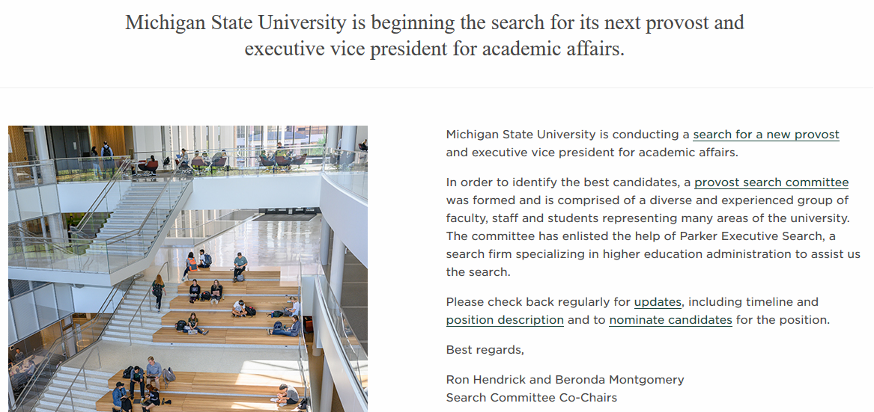
Search Overview
https://msu.edu/provostsearch/

Slide 5
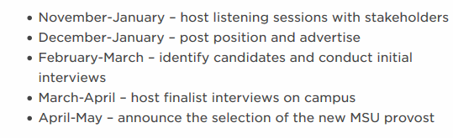
Search Overview Timeline
https://msu.edu/provostsearch/

Slide 6
Upcoming Listening Sessions
February 12, 2020 at 3:30 PM, Lake Huron – MSU Union
(Faculty)
February 18, 2020 at 3:30 PM, Lake Huron – MSU Union
(Staff)
February 19, 2020 at 7:00 PM, Lake Huron – MSU Union (Students)

Slide 7
Strategic Plan Overview Conversation with Interim Provost Teresa Sullivan and Executive Vice President for Health Sciences Norman Beauchamp
January 24, 2020

Slide 8
Key Questions To Address
How can we create an aspirational and meaningful shared institutional vision for the future?
How should MSU position itself for leadership and distinguish itself as a model, next-generation, land-grant institution?
How can we leverage our collective resources and anticipate society’s evolving needs to establish cross-institutional priorities and initiatives?
What does the fourth industrial revolution and the new economy mean for MSU and those it serves?
How do we answer the intractable institutional challenges (i.e., deferred maintenance, financial position)?
How will we align our skills, incentives, and resources to create a plan to achieve our collective vision?

Slide 9
Steering Committee Deliverables
Review our mission and values
Develop and recommend strategic themes based on campus engagement
Aggregate themes and develop strategic plan framework for recommendation to President Stanley and the Board of Trustees
Coordinate and provide leadership to working groups to address strategic themes
Identify and recommend key strategic goals and objectives
Produce a strategic plan for recommendation to President Stanley and the Board of Trustees
Make recommendations for implementation

Slide 10
Strategic Planning Process & Timing
Input Gathering
Integration to Vision
The Plan
January - May 2020
June - October 2020
October 2020 - March 2021
Listening to our stakeholders
Senior Leadership retreat
Reaffirming and restating what we heard via feedback loops
Translating themes into strategic goals and objectives
Framing the future of MSU
Strategic Direction and Framework

Slide 11
Diversity, Equity and Inclusion Steering Committee Brief Overview
Conversation with Interim Provost Teresa Sullivan and Executive Vice President for Health Sciences Norman Beauchamp
January 24, 2020

Slide 12
Principles for DEI Planning Process
Facilitate an inclusive, campus-wide process through which key stakeholders co-design the DEI plan
Discover and embrace a set of shared values for the campus community and stakeholders
Foster an open, iterative process with a high value placed on two-way communication
Coordinate with the University Strategic Plan Steering Committee to build an integrated approach to university planning efforts

Slide 13
Principles for DEI Planning Process Cont’d.
Develop a plan that is evidence based and data informed
Utilize benchmarking activities to review other successful university DEI initiatives
Look internally to examine our current DEI efforts to identify strengths and opportunities
Look externally to understand the changing DEI dynamics facing higher education nationally

Slide 14
DEI Steering Committee Deliverables
University-wide inventory of DEI efforts and initiatives.
Feedback across campus and from alumni and external partners.
Best practices and insights from benchmarking.
Recommendations for: (a) metrics, central and unit based, to measure on-going progress for DEI across MSU; and (b) unit/role accountability for DEI initiatives and outcomes across MSU.
Recommendations for a Strategic DEI planning process for the university, with short-term, mid-range, and long-term action items and goals, with the end goal of making MSU a national leader in this area.

Slide 15
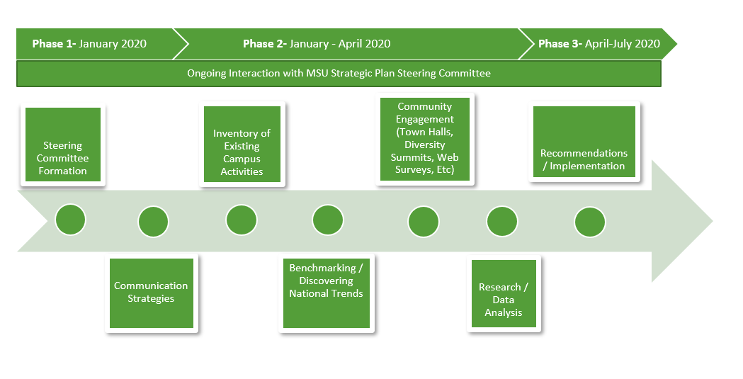
DEI Steering Committee Process Flow and Timeline

Slide 16
Health Sciences
Health Sciences
Norman J. Beauchamp Jr., Executive Vice President for Health Sciences

Slide 17
Blank slide

Slide 18
Admissions totals

Slide 19
In-State Admission

Slide 20
Domestic out-of-state admissions

Slide 21
International admissions

Slide 22
Blank slide

Slide 23
Q&A
Q&A

