Slide 1
FRIB Update
Paul Mantica
FRIB Project Manager

Slide 2
Alignment of Missions
MSU Mission
To advance knowledge and transform lives by
providing outstanding undergraduate, graduate, and professional education
conducting research of the highest caliber
advancing outreach, engagement, and economic development activities that are innovative, research-driven, and lead to a better quality of life
DOE Office of Nuclear Physics Mission
To discover, explore, and understand all forms of nuclear matter. Support experimental and theoretical research - along with the development and operation of particle accelerators and advanced technologies - to create, detect, and describe the different forms and complexities of nuclear matter that can exist in the universe, including those that are no longer found naturally
FRIB Laboratory Vision
Be the world's leading laboratory for education and research in rare isotope science, in accelerator science, and in applications of rare isotopes to meet societal needs

Slide 3
FRIB in the National Context
The 2015 Long Range Plan for Nuclear Science: Reaching for the Horizon lays out a compelling vision for 21st century Nuclear Science in the nation
FRIB is an essential part of this plan
establishment and operation of FRIB as a DOE Office of Science User Facility
FRIB has an obligation to support stewardship of this plan
unique opportunity for MSU leadership
demonstrate responsible and beneficial use of public funds
FRIB affords an opportunity to become the world-leading laboratory in low-energy nuclear science, with
the highest power heavy-ion accelerator and a world-leading fragment separator
world-class and some world-leading instruments
a theory effort commensurate with the experimental discoveries opportunities
Leading to
discoveries that will fundamentally change our understanding of atomic nuclei
And support the nation’s needs in
affording harvesting opportunities for rare isotopes
training the next generation of nuclear scientists knowledgeable in atomic nuclei

Slide 4
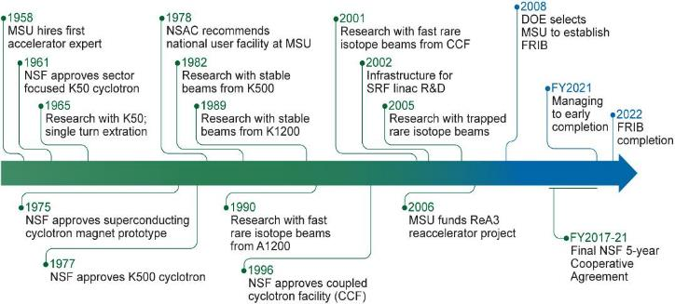
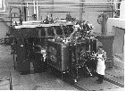
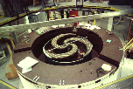
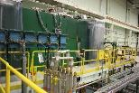
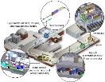
Accelerator Innovations have driven Discovery Science at MSU
The Science Questions from the 2015 Long Range Plan for Nuclear Physics:
How did visible matter come into being and how does it evolve?
How does subatomic matter organize itself and what phenomena emerge?
Are the fundamental interactions that are basic to the structure of matter fully understood?
How can the knowledge and technical progress provided by nuclear physics best be used to benefit society?
K50 | K500 | K1200 | CCF | ReA | FRIB
Light ions | Heavy ions |  | Rare isotopes
Reactions | Reactions |  | +Structure, +Astro |  | +Applied, +Fundamental
Nucleon-nucleus interaction | Nuclear temperature, transport theory |  | Drip lines, new isotopes, shell evolution |  | Predictive nuclear model, origin of elements, application of isotopes

Slide 5
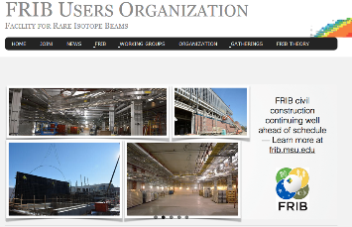
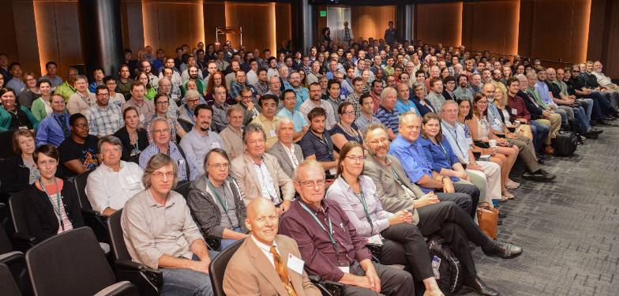
User Engagement Critical to Realize Scientific Discovery
Nuclear Structure
Applications
Users are organized as part of the independent FRIB Users Organization (FRIBUO) www.fribusers.org
Chartered organization with an elected executive committee
Approximately 1,398 members (118 U.S. colleges and universities, 13 national laboratories, 52 countries) as of 13 February 2019
19 working groups on instruments
Nuclear Astrophysics
Symmetries
Next community meeting at TUNL in August 2019
Science Advisory Committee (SAC)
Review of equipment initiatives (February 2011)
Review of FRIB integrated design (March 2012)
Review of equipment working group progress (October 2013)
Review of experimental equipment plans (March 2015)
Review day-1 science program and major equipment status (December 2016)
Review user engagement and Theory Alliance programs, consider plans for PAC, 400 Mev/u upgrade (July 2018)
Nearly 260 users participated in the most recent community meeting (August 2018) held at FRIB

Slide 6
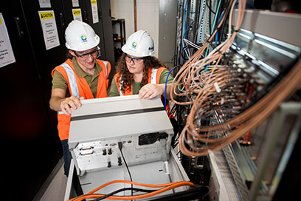
Training the Next-generation Workforce to Meet National Need
Experimental Nuclear Science
Annual review of experimental need
Data on faculty and lab staff engagement in low-energy nuclear science compiled and updated
Activity of FRIBUO’s 19 working groups evaluated by SAC; priorities set by LRP
Considering faculty bridge program to address needs
Nuclear Theory
FRIB Theory Alliance in place in response to theory workforce survey
Fellow and bridge faculty programs established
Radiochemistry
Strategic faculty hire in radiochemistry, joint with Chemistry
Workforce survey completed as part of National Academy report in 2012
MSU Cryogenic Initiative
Involves FRIB and College of Engineering
Develop and maintain a knowledge base of cryogenic technology and skills
Accelerator Science and Engineering Traineeship (ASET)
DOE-SC Office of High Energy Physics award to address a national shortage in accelerator scientists and engineers
MSU received the sole award in FY2017
Leverage FRIB to advance accelerator science and engineering for the nation
Collaboration between faculty in the Department of Physics and Astronomy in the College of Natural Science, the College of Engineering and FRIB
Includes adjunct faculty from Stanford and Fermilab
The AS&E certification in one of the following areas:
Physics and engineering of large accelerators
Superconducting radio frequency technology
Radio frequency power engineering
Large-scale cryogenic systems

Slide 7
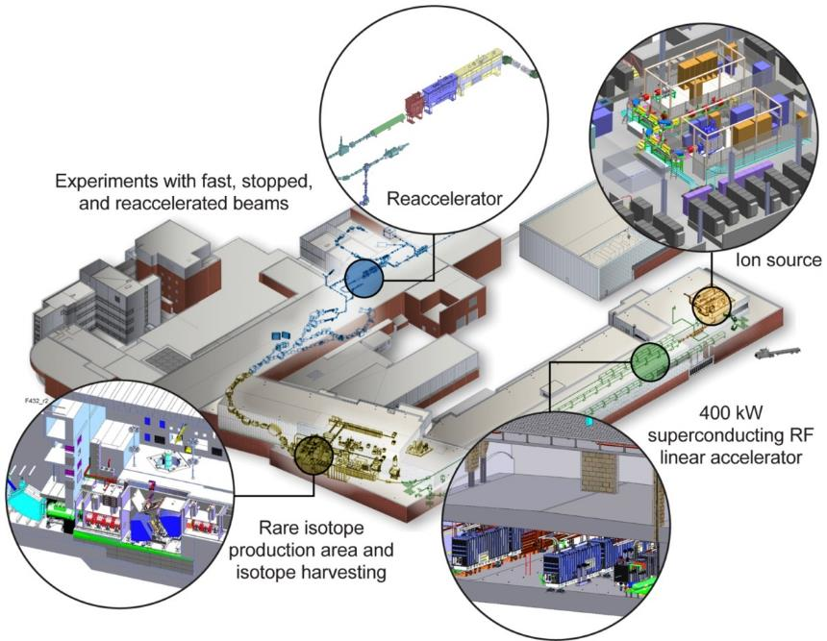
Facility for Rare Isotope Beams A Future DOE-SC Scientific User Facility for Nuclear Physics
Funded by U.S. Department of Energy Office of Science (DOE-SC) supporting the mission of the Office of Nuclear Physics in DOE-SC
Serving over 1,350 users
Key feature is 400 kW beam power for all ions (5x10¹³ ²³⁸U/s)
Separation of isotopes in-flight
Fast development time for any isotope
Suited for all elements and short half-lives
Fast, stopped, and reaccelerated beams
Project on schedule and within budget
Managing to early completion in December 2021

Slide 8
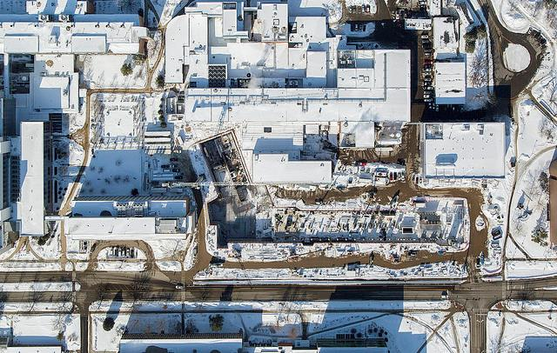
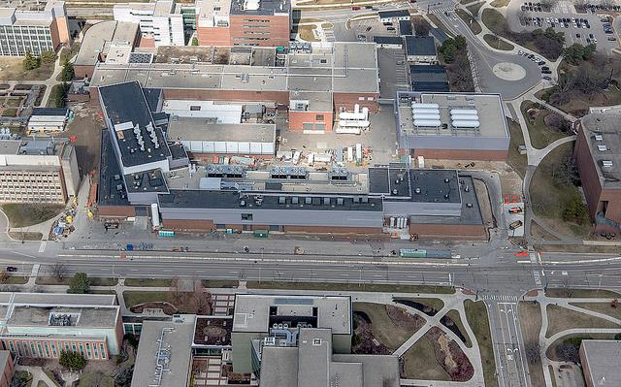
Civil Construction Completed on Budget and Ahead of Schedule
Winter 2015
Groundbreaking for civil construction was held 17 March 2014
Spring 2017
Beneficial occupancy of the FRIB building was achieved 24 March 2017

Slide 9
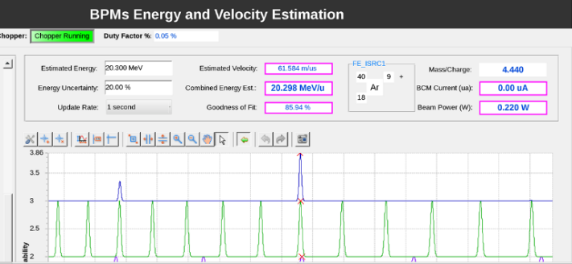
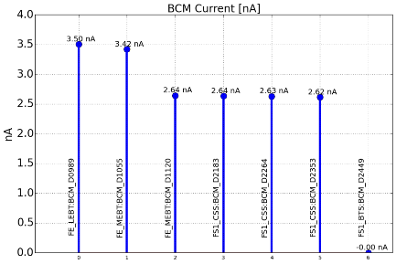
Technical Construction On Track to Meet Early Completion in December 2021
Commissioned first segment of the linac – now the world’s highest energy superconducting linear accelerator
100% beam transmission

Slide 10
Responsive to Stakeholder Requirements Within MSU’s Collaborative Environment
Acknowledge and understand the regulatory framework
Seek clarification
Challenge constraints and test assumptions repeatedly
Manage to the requirements
Adopt/establish standards for self assessment
ISO 14001:2015 - Environment, since 2006
OHSAS 18001:2007 - Safety, since
ISO 9001:2015 - Quality, since 2008
ISO 27001:2013 – Information Security, since 2018
Implement best practices and communicate lessons learned
Reach out to external/internal partners and practitioners for advice
Exercise good judgment
Strive for continuous improvement
In processes, people, and outcomes

Slide 11
Transitioning to FRIB Operations
FRIB Project 90% complete
Critical Decision-4 (project complete) June 2022
FRIB Operations Cooperative Agreement with DOE in place
Operations funding profile established through January 2023
Cooperative Agreement with NSF to operate NSCL will end
Current agreement runs through September 2021
Transitioning research component of agreement to multi-investigator research grants
DOE Office of Nuclear Physics desires to be major supporter of FRIB research
FRIB Theory Alliance
Multi-investigator research grants
New instrumentation
Separator for Capture Reactions (SECAR)
Gamma Ray Energy Tracking Array (GRETA)
High Rigidity Spectrometer (HRS)
FRIB Decay Station
Reaccelerator 12 MeV/nucleon (ReA12) capability
Isochronous Spectrometer with Large Acceptance (ISLA)
Solenoid Spectrometer Apparatus for Reaction Studies (SOLARIS)
New capabilities
Linac energy upgrade to 400 MeV/nucleon
Isotope harvesting
Faculty may seek additional funding from other agencies (as they do now)
NNSA Stewardship Science Academic Alliance (SSAA), NNSA Nuclear Science and Security Consortium (NSSC), NSF Physics Frontiers Centers (JINA-CEE), OHEP Accelerator Science and Engineering Traineeship (ASET), others
FRIB will continue to be aggressive in pursuing federal research dollars to realize its mission and vision

Slide 12
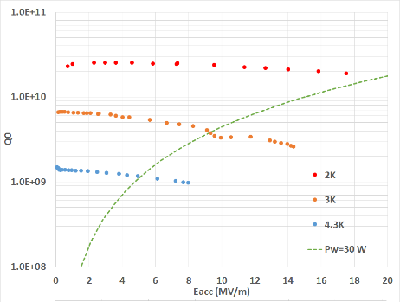
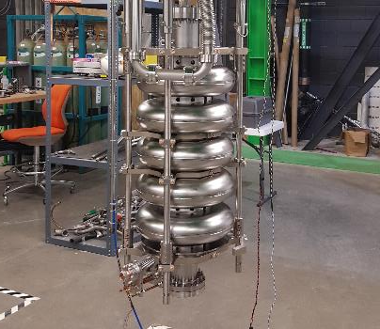
3.7.9 FRIB Energy Upgrade 400 MeV/nucleon for U
Provides an order-of-magnitude higher rate for key nuclei near the neutron drip line important to model nucleosynthesis in neutron star mergers
Opens new opportunities to determine the neutron matter equation of state
Based on β_{OPT}=0.65, 644 MHz superconducting elliptical cavities
55 cavities in 11 cryomodules at 17 MV/m accelerating field
Focusing with warm quadrupoles
15 kW RF amplifiers
Pre-R&D supported by MSU includes development and construction of 4 elliptical cavities, 2 tuners, 2 RF couplers and construction of a test cryomodule housing 2 cavities
Prototyping and R&D are required for the SRF facility upgrade at MSU/FRIB and for the design, construction and testing of a prototype cryomodule with 5 cavities
Layout
Cold and radiofrequency testing results of the first R&D cavity

Slide 13
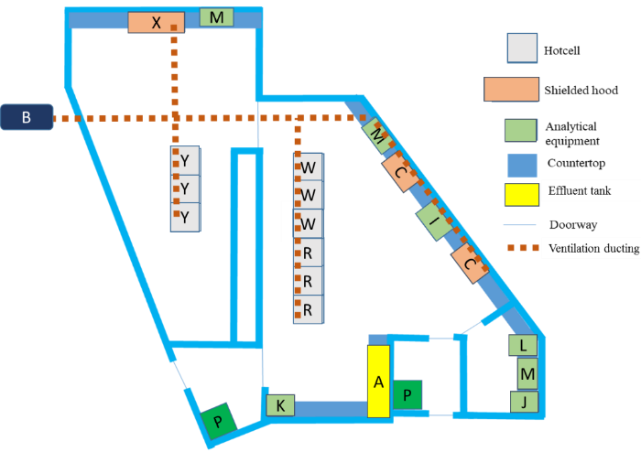
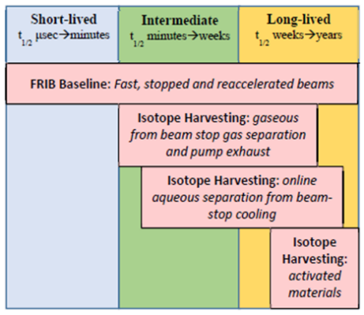
Isotope Harvesting
Synergistically harvest and utilize valuable by-product rare isotopes from FRIB
FRIB will produce radioisotopes which, as stated in the NSAC-I LRP “…are currently in short supply or have no source other than FRIB operation”
Focus areas
Medicine: theranostic isotopes for precision diagnostics and therapy
⁴⁷Sc, ⁶⁷Cu, ⁷⁶Br, ²¹¹At, etc.
Fundamental Symmetries: Electric Dipole Moment search candidates
²²⁵Ra, ²²¹Rn, ²²³Rn, and ²²⁹Pa
Stockpile Stewardship and Astrophysics: Radioactive targets of radiochemical monitors and branch points
Working group on isotope harvesting at FRIB established in 2010
Representatives from over 10 U.S. institutions, including LLNL, LANL, ORNL and BNL
Engaging potential users from applied fields
Radiology, Plant Sciences, Material Sciences, etc.
Pre-conceptual design of isotope harvesting laboratory, which may be located in the new experimental vault funded by MSU

Slide 14
Summary
FRIB will be a DOE Office of Science User Facility
Meets a national need
Aligned purpose between DOE, MSU, and FRIB Laboratory
FRIB Project on schedule and budget, and will deliver scope with high quality to meet DOE mission need
Managing to requirements
Outcome-focused
Project endeavor improves the institution
Relationships are key
Transparent communication
Shared understanding
Cooperative environment
Agility to adapt to new information

