Slide 1
Conversation with
Kathleen M. Wilbur, Ph.D.
Executive Vice President for
Government, Communications, and Advancement
March 25, 2019

Slide 2
State Relations
David W. Bertram
Associate Vice President for State Relations

Slide 3
MSU State Relations
Political Landscape
  Governor Whitmer (Spartan Alum) – Key Appointments
    Chris Kolb – State Budget Director
    Liesl Clark (Spartan Alum) – MDEQ Director
    Gary McDowell – MDARD Director
    Daniel Eichinger (Spartan Alum) – MDNR Director
    Paul Ajegba – MDOT Director
    Greg Bird (Spartan Alum) – Legislative Director
    Emily Laidlaw (Spartan Alum) – Policy Director
    Jen Flood (Spartan Alum) – Public Affairs Director
    Mark Totten (Spartan Alum) – Chief Legal Counsel
  House GOP in Majority (58-52) – Democrats gained 5 seats in Nov. election
  Senate GOP in Majority (22-16) – Sen. Dems also gained 5 seats in Nov. election
  New legislative leadership – three of four leaders new (all term-limited)
  47 freshmen in the House out of 110 total; 7 out of 38 in the Senate
  Spartan Caucus has 28 MSU Alums in the Legislature

Slide 4
MSU State Relations (cont’d)
State Budget FY 2020 (Proposed by Governor Whitmer)
  Presented to the Legislature on March 5
  Higher Education Funding
    3% increase for all 4-year public institutions
      Higher Education Funding not being run through formula
      = $43.7M 4-year public institutions
      = $8.6M MSU
    3% increase for AgBioResearch/MSUE

Slide 5
MSU State Relations (cont.’d, 2)
State Budget FY 2020 (Proposed by Governor Whitmer)
  Higher Education Funding (cont.’d)
    $500 million currently coming from SAF to support 4-year public institutions has been shifted to General Fund
    3% increase for community colleges but $400 million from SAF continues to be used for as a part of their funding
    MI Opportunity Scholarship – 2 years tuition free community college
    Michigan Reconnect – adults upskill tuition free pathway (certificate or Associate Degree)
    Higher Education 3% increase based on 45 cent a gallon gas tax approval

Slide 6
MSU State Relations (cont.’d 3)
Other Budget Items
  Agriculture Funding (MDARD Budget did not include a new farm stress line item) $1.5 million
  $120 million included by the Governor to assist communities with copper, lead, and PFAS related remediation (General Fund dollars)
  Capital Outlay – Projects scored but not included in the Governor’s budget recommendations (MSU Project – Plant Science Greenhouses $20 million – $5M – MSU)

Slide 7
MSU State Relations (cont.’d 4)
Legislation
  SJR E (McBroom) – Amends the constitution related to open meetings, stating that all meetings of public universities be open to the public (informal meetings - ?)
  HJR F (Koleszar) – Eliminates the SAF utilization for higher education
  Community College Baccalaureate Degrees (not yet introduced)
  Teacher Preparation Package (not yet introduced)
    Likely would require 30 Hours of continuing education (from a list of items)
    Likely to require a $1,000 stipend to teachers who supervise student teachers

Slide 8
Federal Relations
Sarah Walter
Associate Vice President for Federal Relations

Slide 9
Michigan Delegation
The state of Michigan has two senators in the United States Senate and 14 representatives in the United States House of Representatives
New Members
  Elissa Slotkin (home Congressional district member)
  Andy Levin (9th Congressional district member)
  Haley Stevens (11th Congressional district member)
  Rashida Tlaib (13th Congressional district member)

Slide 10
Upcoming Federal Priorities
Agriculture
Higher Education Act Reauthorization
Immigration Policy
National Security and Research
Federal Appropriations
    Shutdown and FY19 Omnibus
    FY20 Budget Request
    Agency funding and initiatives such as FRIB, GLBRC, and IACMI

Slide 11
FY20 White House Budget Request
Continues trend from past two years of recommending deep cuts in domestic funding
Department of Energy
    Advanced Research Projected Agency – Energy eliminated (again)
    Office of Science: 16% cut
  EPA Office of Science & Technology: 31% cut
  Great Lakes Restoration Initiative: 90% cut
  National Institutes of Health: 12% cut
  National Science Foundation: 12% cut
  Pell Grants: rescinds $2 billion from surplus with maximum award held at $6,195
  However, USDA’s Agriculture & Food Research Initiative (AFRI) received an $85 million increase to $500 million.

Slide 12
Congressional Response to White House Budget Request
As in the past two years, Congress is expected to largely ignore the White House
Department of Energy
  Advanced Research Projected Agency – Energy
      FY18: Request = elimination Final = $353 million (+15% over FY17)
      FY19: Request = elimination Final = $366 million (+4% over FY18)
  Office of Science
      FY18: Request = 16% cut Final = $6.2 billion (+12%)
      FY19: Request = 16% cut Final = $6.5.8 billion (+4.6%)
  EPA Office of Science & Technology
    FY18: Request = 38% cut Final = $706 million (equal to previous year)
    FY19: Request = 29% cut Final = $706 million (equal to previous year)
  Great Lakes Restoration Initiative
  FY18: Request = elimination Final = $300 million (equal to the previous year)
  FY19: Request = elimination Final = $300 million (equal to the previous year)

Slide 13
Congressional Response to White House Budget Request -- continued
National Institutes of Health
  FY18: Request = 21% cut Final = $37.1 billion (+8%)
  FY19: Request = 4% increase Final = $39.1.6 billion (+5%)
National Science Foundation
  FY18: Request = 11% cut Final = $7.7 billion (+4%)
  FY19: Request = 4% cut Final = $8.1 billion (+5%)
Pell Grants
  FY18: Request = rescind $3.9 billion in surplus. Max. award held at $5,920
  Final = no rescinding of surplus and max award increased to $6,095
  FY19: Request = (no request to rescind portion of surplus). Max. award = $5,920 Final = rescinded $600 million of surplus. Max. award =$6,195
USDA’s AFRI
  FY18: Request = 7% cut Final = $400 million (+7%)
  FY19: Request = 6% cut Final = $415 million (+4%)

Slide 14
Community Relations
Janet Lillie, Ph.D.
Assistant Vice President for Community Relations

Slide 15
Local Community Relations for Global Lansing area
Role serves as a catalyst for opportunities and encourages mutually beneficial partnerships between MSU and entities in the global Lansing region
Historically the focus was on East Lansing, however, faculty, staff and students live across the region – current focus on tri-county area because MSU greatly impacts area !!
Top three areas where MSU faculty and staff live, 2011 to 2019:
  Meridian Township: 2390 to 2457 (+67)…2.8% increase
  Lansing: 1768 to 1812 (+44)…2.5% increase
  East Lansing: 1864 to 1684 (-180)…9.6% decrease
  NOTE: MSU employees increased by 281 in local area from 2011 to 2019

Slide 16
Students live throughout region as well:
69% (35K) live off campus including out of area
  25K live in local area
  13K of the 25K off campus students live in East Lansing
High density student area with greatest decrease is the EL Bailey area
  (19% decrease since 2015) or 5196 to 4231 (prelim number)
  Note that rental licenses are not decreasing, just density
Area with greatest increase is Eastside Lansing
  (50% increase since 2016) or 669 to 1004
  In part due to SkyVue, other apartments, and new retail (coffee shop, brewery)
Why does this matter??

Slide 17
Brain Drain or Gain when students graduate?
Spring/Summer 2018 graduates (7295 graduates)
1259 are staying in area*
- 660 employed
- 599 continuing their education
- almost triples what we started with (436)
*Area defined as Lansing, East Lansing, Okemos, Mason,
St. Johns, Dewitt, Eaton Rapids, and Charlotte

Slide 18
Example current projects:
Off Campus Student Health and Safety
Facilitating connections with Lansing Community College
Census 2020
Follow progress on local developments such as Center City II, The Hub, Park District, Park Place (upwards to 1000 new student apartments) and more on the way
Participate in community projects/conversations on regionalism, workforce development, placemaking, etc.

Slide 19
Statewide Advocacy
Jeremy Reuter
Director for Statewide Advocacy

Slide 20
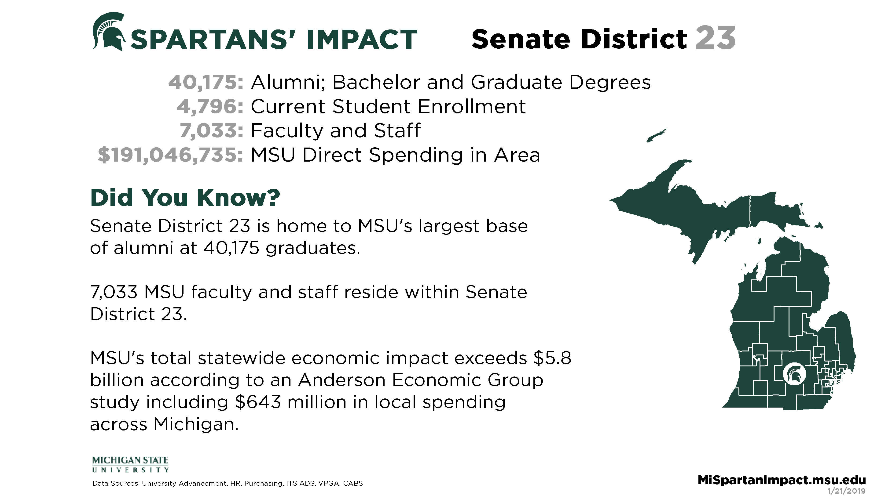
Spartans’ Impact
mispartanimpact.msu.edu

Slide 21
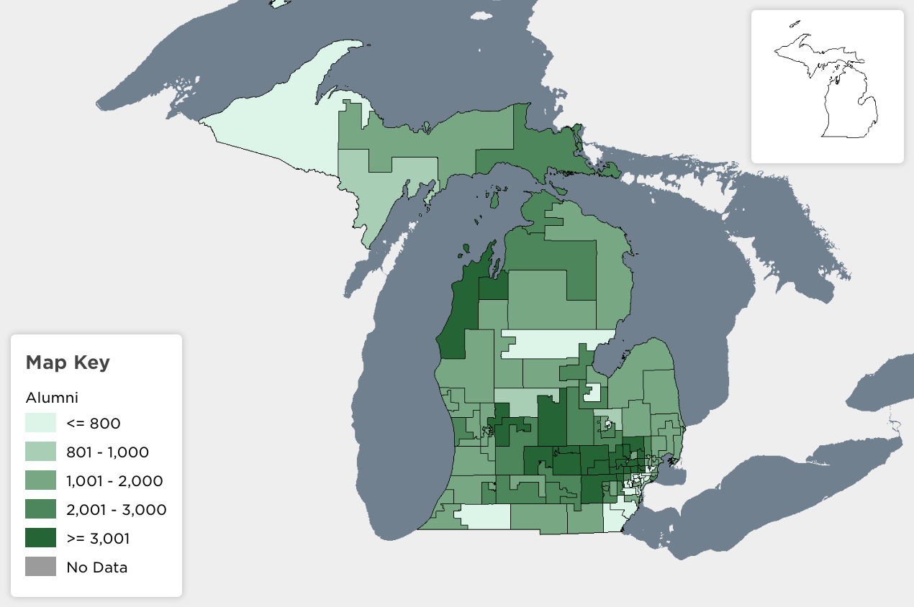
MiSpartanImpact.msu.edu
mispartanimpact.msu.edu

Slide 22
University Communications
Merri Jo Bales
Vice President and Strategic Director for
University Communications

Slide 23
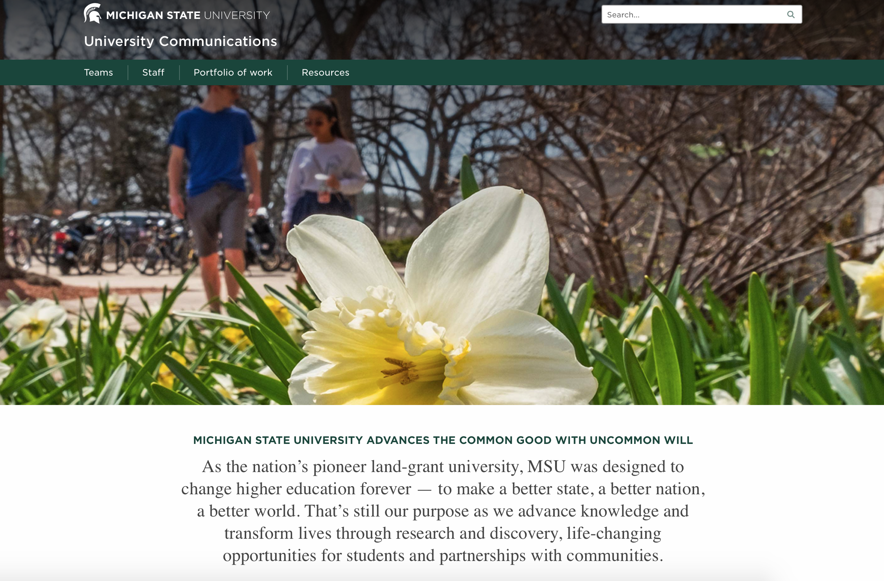
Screenshot of University Communications Website

Slide 24
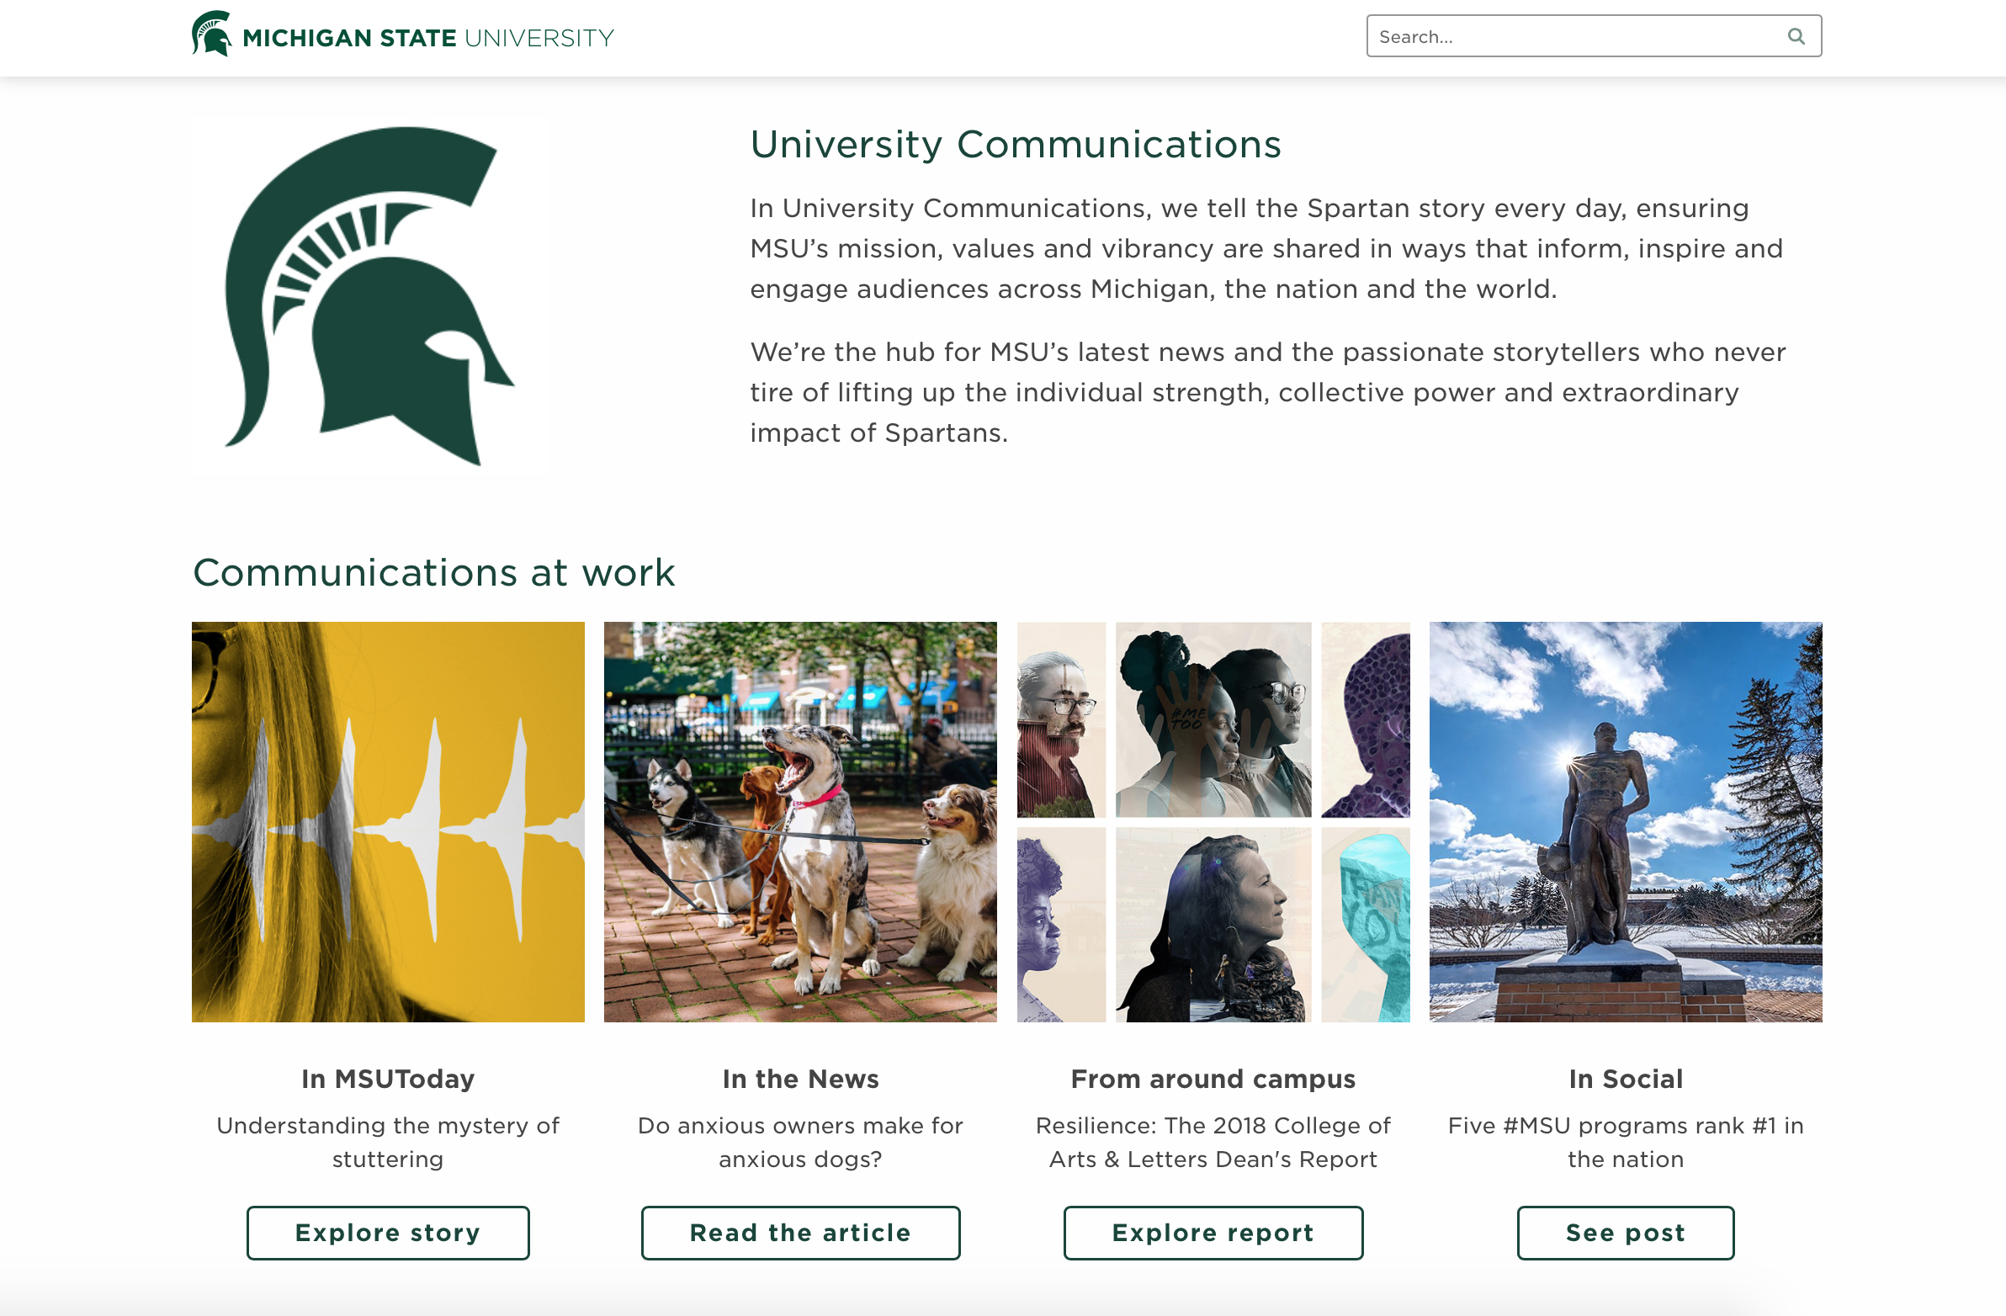
Lower on the homepage of University Communications

Slide 25
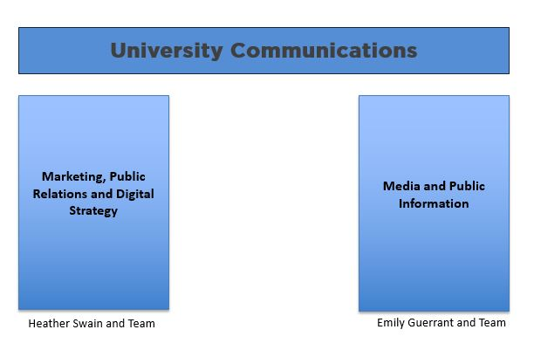
University Communications structure

Slide 26
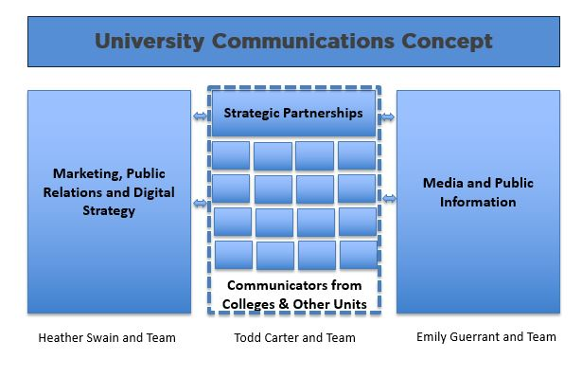
University Communications Concept

Slide 27
Marketing, PR & Digital Update
Advancing MSU’s Distinctiveness and Reputation
Story-first, content driven strategy
Integrated approach: earned (PR), owned (web, email), shared (social) and paid (advertising, sponsored) media to drive content visibility and consumption
Paid media also supports:
  Community growth (more MSUToday subscribers, social followers)
  Undergraduate student recruitment/conversion
  Visibility of content with academic peers
Collaborate on content with communicators across MSU
Work with faculty to communicate importance and impact of work to public and stakeholders
Reorganization to better support Partnership and Alignment, Marketing Operations

Slide 28
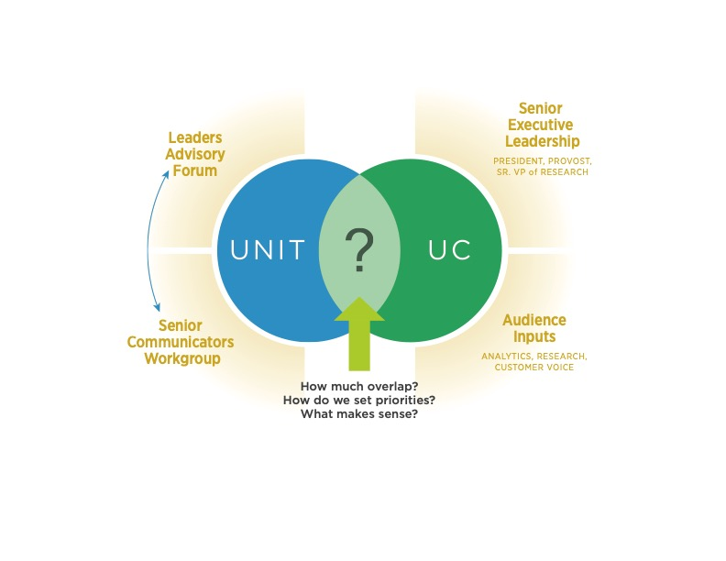
Partnership and Alignment:
Shared Priorities and Work Agenda
Strong Foundational Elements
Crisis & Issues Mgt. Emergency Comms Internal Comms | Brand Strategy Marketing/Content Strategy Digital & Social Templates & Tools | Hiring & Onboarding Talent Development Performance Development | Analytics & Insight Marketing Research Mar. Tech. Adoption

Slide 29
Marketing Operations Update
Insights Efforts Consolidating communications data in central database Centralizing/standardizing tools Building team Developing plan, roadmap, and methodology
Marketing Technology Efforts Implementing core technologies/capabilities with IT Web content management Constituent relationship management Email marketing Social marketing
Notes:
Heather Swain

Slide 30
Marketing Operations Update: Web CMS Initiative
Status Selected Sitecore Digital Experience Platform Selected Valtech as implementation partner Discovery phase kickoff in April
Benefits Reduce time/cost to build websites Expertise will deepen around a single platform Enhanced features (e.g., personalization)
Things to Know Now Current phase includes MSU.edu and MSUToday Scaling back development during transition Preferred web contract should be used New sites early 2020 Not eliminating Cascade but will not develop in it
Notes:
Heather Swain

Slide 31
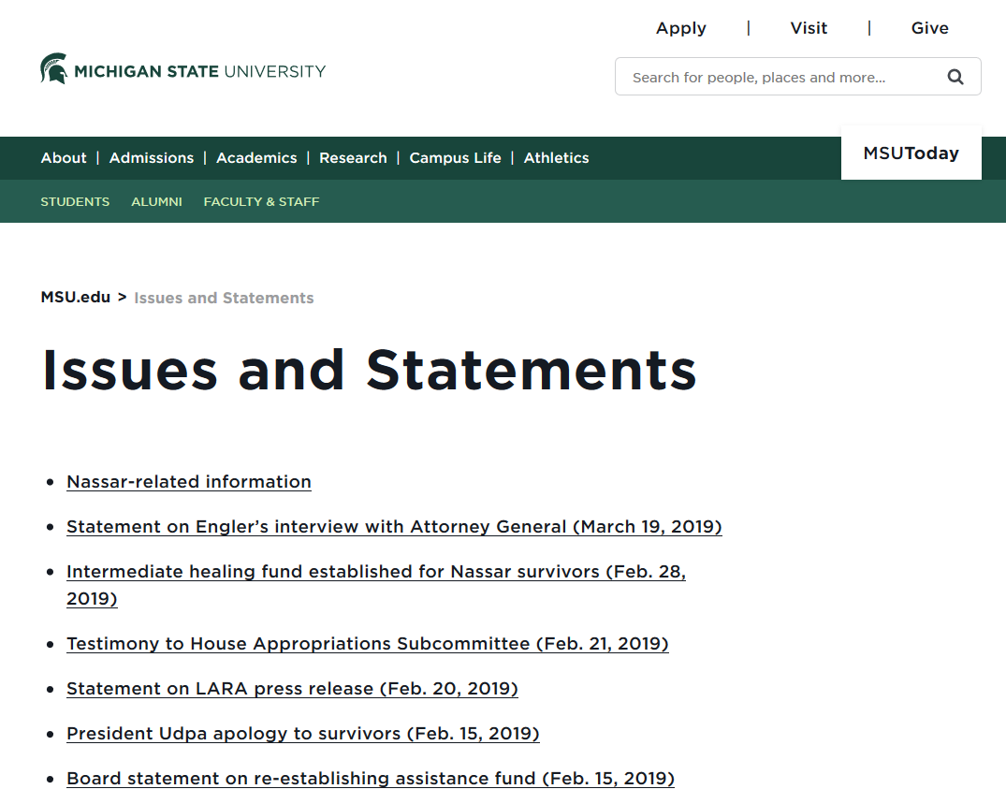
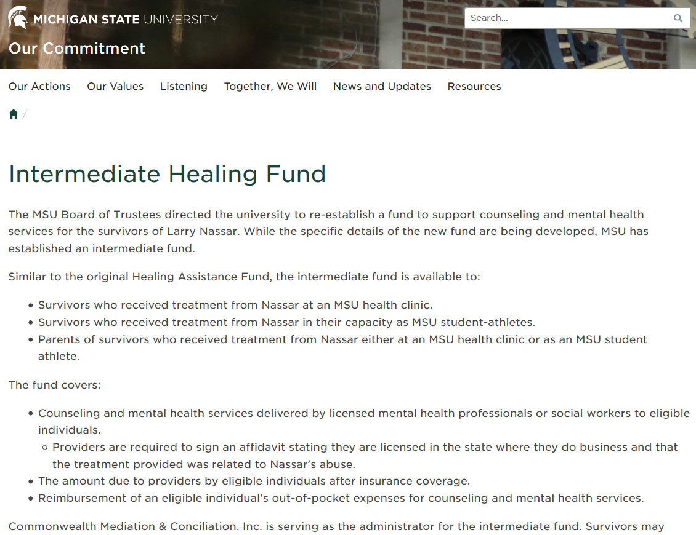
Media & Public Information
New Issues and Statements Webpage
  Accessible from msu.edu
Intermediate Healing Fund
Coming Soon
  New Our Commitment webpage
EG

Slide 32
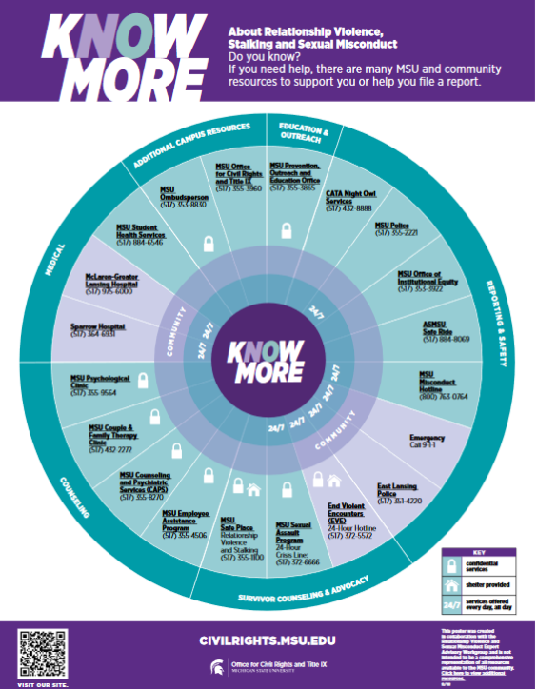
Media & Public Information (continued)
Campus Climate Survey
  Launched last week
It’s On Us Week
  Student lead activities,
  March 31-April 6
Former President Simon Trial Dates
  April 8, 9, 16
Next Board of Trustees Meeting
  April 12
MSU Museum Exhibit
  April 16

Slide 33
University Advancement
Marti Heil
Vice President for University Advancement

Slide 34

Empower Extraordinary Campaign
$1.8 BILLION!
The Empower Extraordinary Campaign is Michigan State University's third comprehensive capital campaign

Slide 35
Strengthened the Finances of the University
Added 112 New Endowed Chairs
$781 Million Committed
for Endowments
3,500+ New Scholarships Created
$1.24 Billion Already Received in Either Cash or New Pledges Payable Over 5 Years
35

Slide 36

Campaign Impact Summary
$1.83 billion raised
$1.2 billion already received and here at work
$376 million raised for scholarships
3,500+ new scholarships created
112 new endowed chairs and professorships
35% increase in funds for research
22 significant capital projects initiated
$781 million to grow MSU endowments
255,284 donors
363 gifts of $1 million+ during campaign (242 $1 million+ in all years prior)

Slide 37
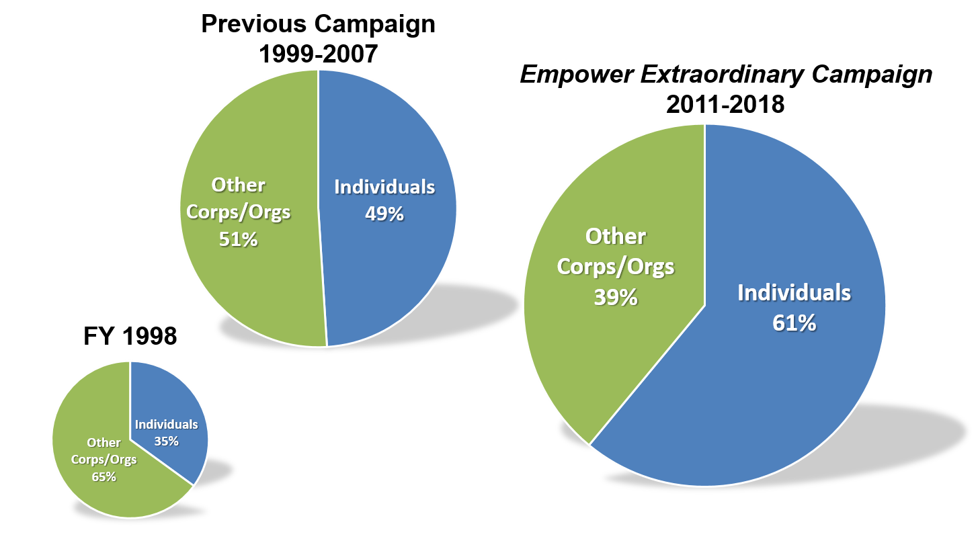
Growing Support from Individuals

Slide 38
Total Gift Production
New Cash, Pledges, In-Kind and Planned Combined
Updated 2/1/19
**FY2018 totals were lower also due to tax law changes in the treatment of Athletics seat license gifts and timing of campaign pledge payments. These revenues totaled $15.0 million, which are reflected in the grand totals above.

Slide 39
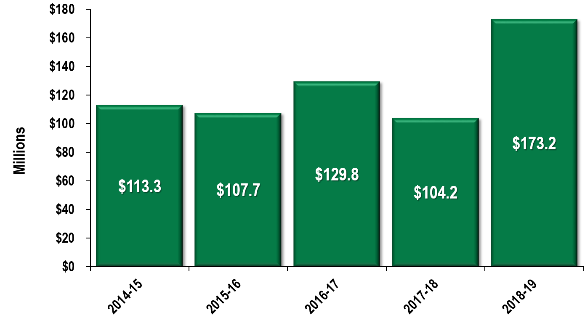
Total Gift Production
- First 6 Months of Fiscal Year -
New Cash, Pledges, In-Kind and Planned Combined
Updated 2/1/19

Slide 40
Begin Planning for the Next Campaign
New screening of database to identify new prospects
Evaluate staff structure to ensure proper alignment
Develop a new staffing plan designed to grow private support
54,000 unassigned prospects currently identified with $50K+ capacity
University Advancement required an additional investment of $6 million/year to execute the Empower Extraordinary Campaign, which helped grow philanthropic support by $100 million annually (incremental cost per dollar raised = 6%)

Slide 41
Contact Information
Merri Jo Bales
Vice President and Strategic Director for
University Communications
mjbales@msu.edu
517-432-0304
David Bertram
Associate Vice President for State Relations
dbertram@msu.edu
517-353-3228
Emily Guerrant
Vice President and University Spokesperson
emilyg@msu.edu
517-355-3853
Marti Heil
Vice President for University Advancement
heil@uadv.msu.edu
517-884-1003
Janet Lillie
Assistant Vice President for Community Relations
lillieja@msu.edu
517-353-9001
Jeremy Reuter
Director for Statewide Advocacy
reuterje@msu.edu
517-353-7171
Heather Swain
Vice President for Marketing, Public Relations,
and Digital Strategy
heather.swain@cabs.msu.edu
517-355-2262
Sarah Walter
Associate Vice President for Federal Relations
walter@msu.edu
202-678-4000
Kathy Wilbur
Executive Vice President for Government,
Communications,
and Advancement
schlage6@msu.edu
517-353-9000

