Slide 1
Facility for Rare Isotope Beams Update
Thomas Glasmacher FRIB Laboratory Director
23 March 2018

Slide 2
Facility for Rare Isotope Beams Project on Track for Early Completion
FRIB Project constructs a $730 million national user facility funded by the Department of Energy Office of Science (DOE-SC), Michigan State University, and the State of Michigan
DOE-SC $635.5 million
State of Michigan $94.5 million
Planned completion date is June 2022, managing to an early completion in 2021
FRIB will be a DOE-SC scientific user facility for world-class rare isotope research supporting the mission of the Office of Nuclear Physics in DOE-SC
FRIB will enable scientists to make discoveries about the properties of these rare isotopes in order to better understand the physics of nuclei, nuclear astrophysics, fundamental interactions, and applications for society
Notes:
No Updates 7/7/17 - CB
No changes 1/24/18 – CB

Slide 3
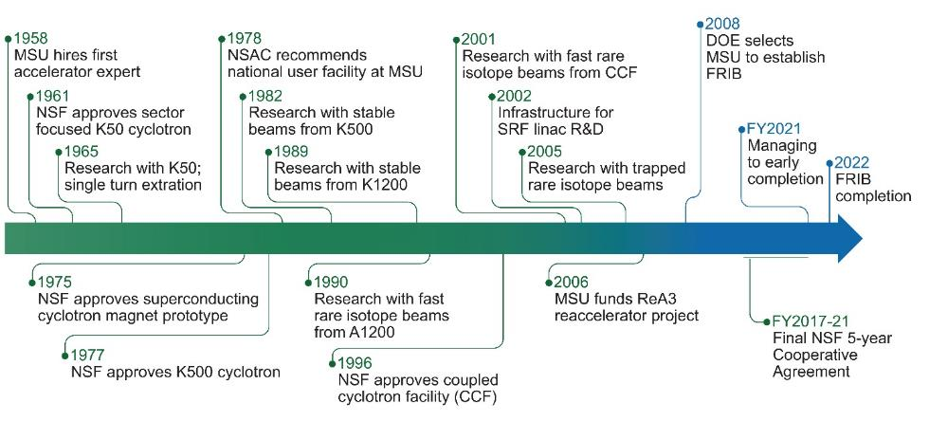
MSU Experience, Assets, and Commitment: Keys to Delivering FRIB
MSU has a 50-year history in accelerator-based science
Cyclotron Laboratory (1965 - 1985)
NSCL, National Superconducting Cyclotron Laboratory (1985 - 2021)
Major reinventions leveraged assets and kept laboratory at cutting edge
1965 proton beams, 1982 heavy ion beams, 1990 rare isotopes, 2001 coupled cyclotrons
MSU won FRIB project in an open competition 2008
FRIB civil construction March 2014 – March 2017
FRIB technical construction started in October 2014
In 2021
FRIB project completes
NSCL stops
FRIB Laboratory starts operation as scientific user facility
Notes:
4/17/2017 – (no updates) LS
No Updates 7/7/17 - CB
No changes 1/24/18 – CB
Added last bullet 1/25/18 – CB

Slide 4
FRIB Enables Scientists to Make Discoveries
Properties of atomic nuclei
Develop a predictive model of nuclei and their interactions
Many-body quantum problem: intellectual overlap to mesoscopic science, quantum dots, atomic clusters, etc.
Astrophysics: What happens inside stars?
Origin of the elements in the cosmos
Explosive environments: novae, supernovae, X-ray bursts …
Properties of neutron stars
Tests of laws of nature
Effects of symmetry violations are amplified in certain nuclei
Societal applications and benefits
Medicine, energy, material sciences, national security
Science is aligned with national priorities articulated by
Nuclear Science Advisory Committee to DOE and NSF Long Range Plan for Nuclear Science (2015)
National Research Council Decadal Survey of Nuclear Physics (2012)
National Research Council Rare Isotope Science Assessment report (2006)
Notes:
No Updates 7/7/17 - CB
No changes 12/19/17 - CB
No changes 1/24/18 – CB

Slide 5
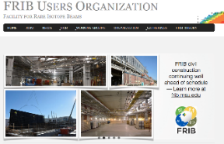
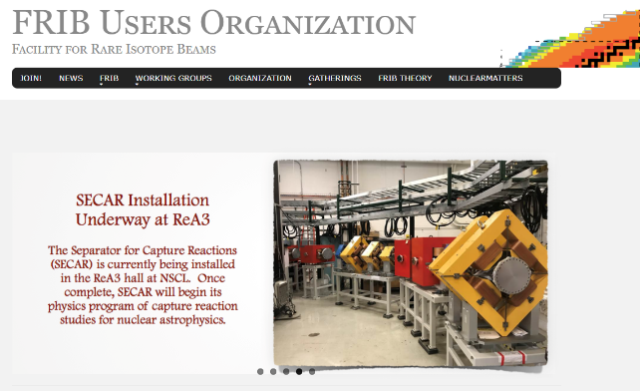
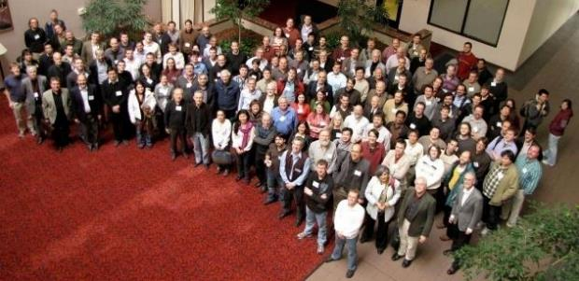
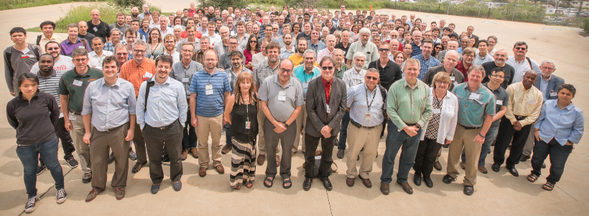
1,400 Users Engaged and Ready for Science www.fribusers.org
Scientific users organized in an independent FRIB Users Organization (FRIBUO)
Chartered organization with an elected executive committee
1,400 members (116 U.S. colleges and universities, 12 national laboratories, 52 countries) as of January 2018
19 working groups on instruments
External Science Advisory Committee
Argonne National Laboratory, August 2017

Slide 6
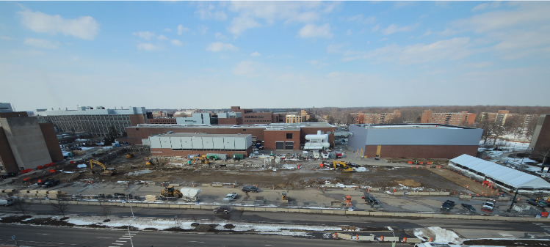
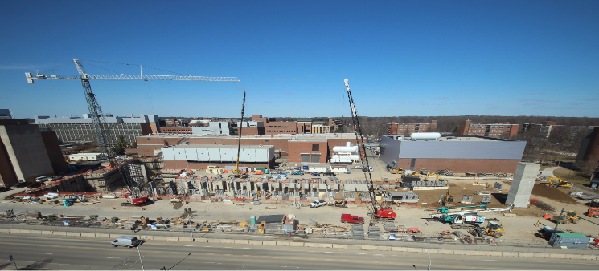
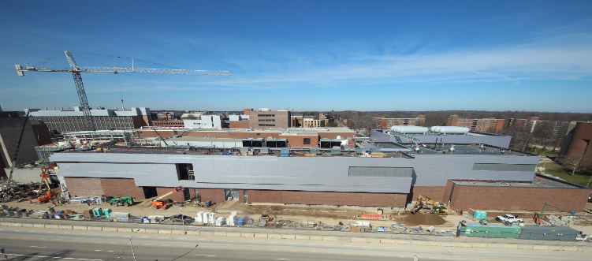
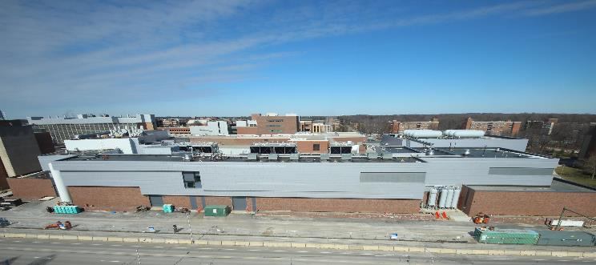
Civil Construction: March 2014 - March 2017
Groundbreaking – March 2014
March 2015
March 2016
Beneficial Occupancy – March 2017
Notes:
Updated image and date on the bottom of the slide - 7/26/17 CB
Updated with September 2017 photo and date – 10/9/17 CB
Updated Images and layout – 10/30/17 CB
No updates – 12/20/17 CB
No Updates 1/24/18 – CB

Slide 7
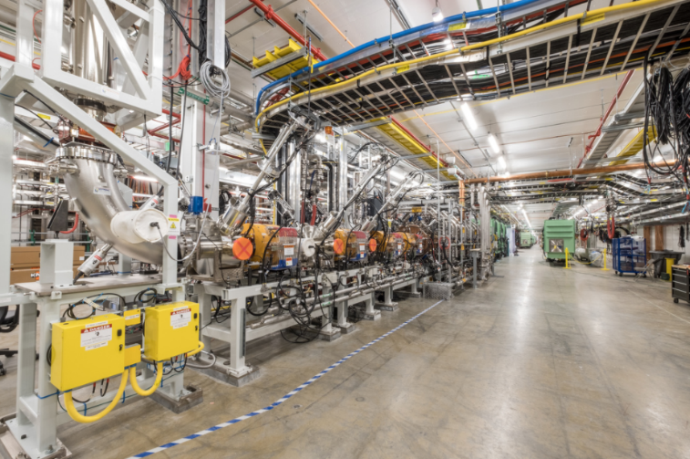
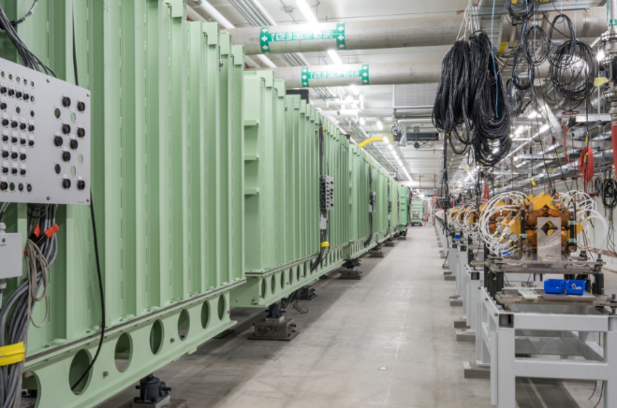
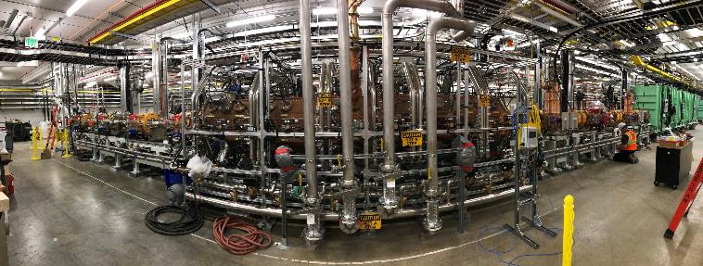
Technical Construction Progressing Ahead of Baseline Schedule: Accelerator
July 2017: Front end – where beam will start – complete, sixteen months ahead of schedule
October 2017: First ion beams accelerated, argon ⁴⁰Ar⁹⁺ and krypton ⁸⁶Kr¹⁷⁺

Slide 8
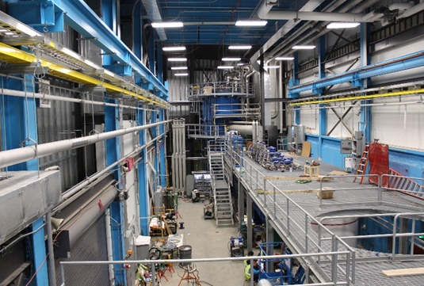
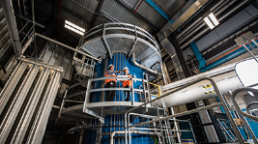
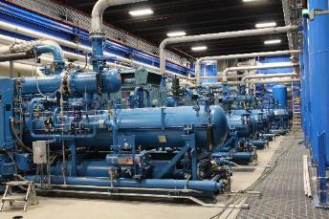
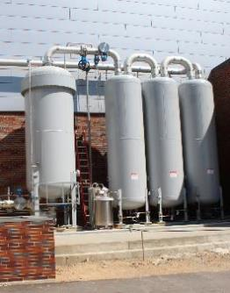
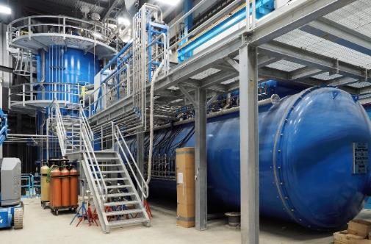
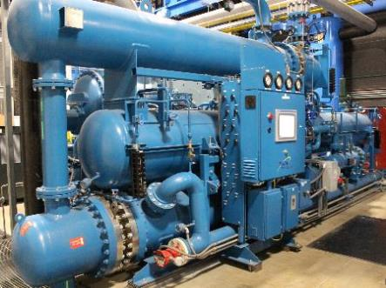
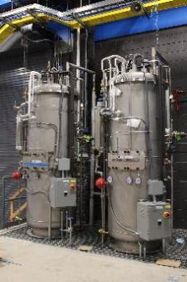
Technical Construction Progressing Ahead of Baseline Schedule: Cryogenic Plant
December 2017: Cryogenic plant is complete, operational, and makes first liquid helium

Slide 9
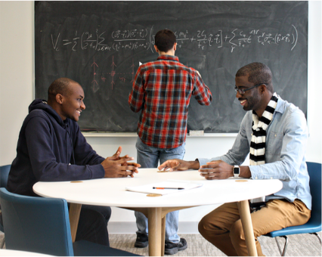
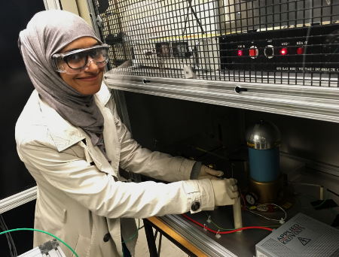
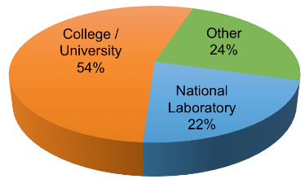
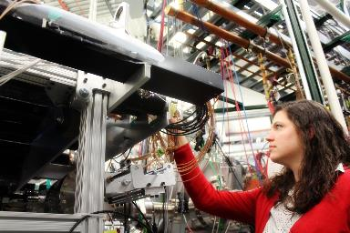
Educating the Next Generation of Scientists and Engineers
MSU nuclear physics graduate program ranked #1 in nation
103 graduate students in Physics, Chemistry, Electrical Engineering, Mechanical Engineering
150 undergraduate students
68 graduate students graduated since 2010
32% female, 68% male
76% United States, 24% international
Median time to Ph.D. is 5.0 years
National median in physics is 6.5 years
Graduating student careers
54% Universities
22% National Laboratories
24% Other
Careers
(all numbers as of Dec 2017)

Slide 10
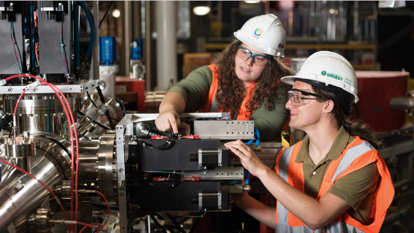
Addressing National Workforce Shortage MSU Accelerator Science and Engineering Traineeship Program Launched in 2017
FRIB, College of Natural Science, College of Engineering launched Accelerator Science and Engineering Traineeship program leverages
18 faculty plus 30 academic staff, focusing on four areas with critical workforce needs:
Design and operation of large accelerator facilities,
Superconducting RF (SRF) technology
RF power engineering,
Large-scale cryogenic systems
Supported by DOE-SC Office of High Energy Physics
Students at the laboratory
80 graduate students (Aug 2017)
62 domestic (77%), 18 international (23%)
20 women (25%)
9 minority (AA/AI/His)
Graduating student careers
59% universities
23% national laboratories
18% other
150 undergraduate students
49 engaged in research
101 engineering, finance, controls, office

Slide 11
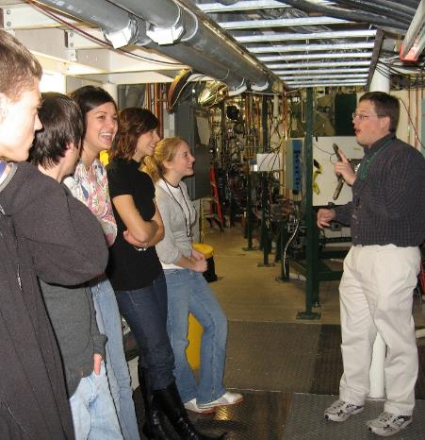
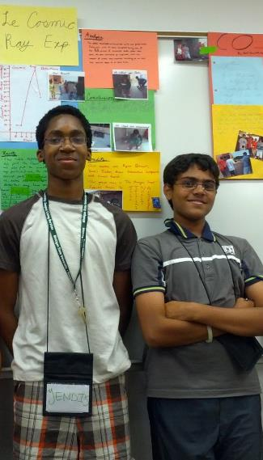
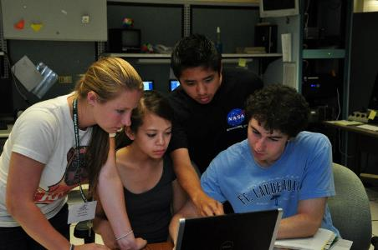
Outreach Efforts Engage Communities Across Michigan
2017 outreach
Tours: 3,066 guests
Talks: 2,505 reached
Programs: 1,516 reached
Programs in public schools and beyond
More than 150 activities in 2017, including Michigan school districts, Colleges, Private schools, Homeschooling groups
Collaborations
Summer program with Gifted and Talented office
PAN summer program assessment with College of Education
Road shows with Detroit schools
MSU Science Festival
MSU Grandparents University
Isotopolis game with MSU Communication Arts and Sciences
Dance of the Isotopes with Wharton Center
Virtual tour with MSU Planetarium
FRIB Exhibit with Impression 5 Museum
2008-2017 outreach
Tours: 36,066 guests
Talks: 19,440 reached
Programs: 27,925 reached
Notes:
Updated user numbers 1/10/8 – CB
Updated User numbers 7/5/17 – LS
Updated MSU Center for Economic Analysis numbers. Added last four bullets under the first section 6/1/2017 – LS
Removed procurement numbers based on TG presentation for Senator Booher 4/25/17 – LS
Procurements and employee salaries are for both FRIB/NSCL
Technology spinoff and manufacturing
Case study: Jefferson National Accelerator Facility (JLab), Newport News, Virginia
$679.1M in economic output and 4,411 jobs annually (national)
$271.1M output and 2,200 jobs in the state
$217.6M and 1,968 jobs remain in metro region
From 2010 Economic Impact Analysis, www.jsallc.org/news/EconImpact2011.pdf

Slide 12
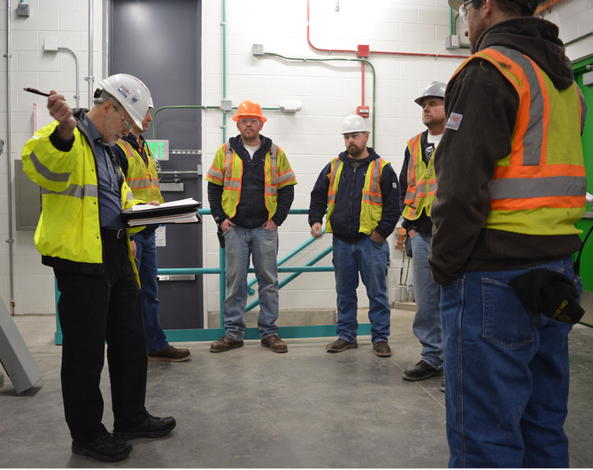
FRIB Approach to Environment, Safety, Health and Quality
FRIB operates under well-defined regulatory framework
U.S. Nuclear Regulatory Commission
Michigan Department of Licensing and Regulatory Affairs
State of Michigan OSHA
Michigan Department of Environmental Quality
MSU Environmental, Health and Safety
FRIB ESHQ management systems are registered to
ISO 14001- Environment, since 2006
OHSAS 18001 - Safety, since 2007
ISO 9001 - Quality, since 2008
by National Sanitation Foundation as external registrar
External ESH Advisory Committee with experts from national laboratories

Slide 13
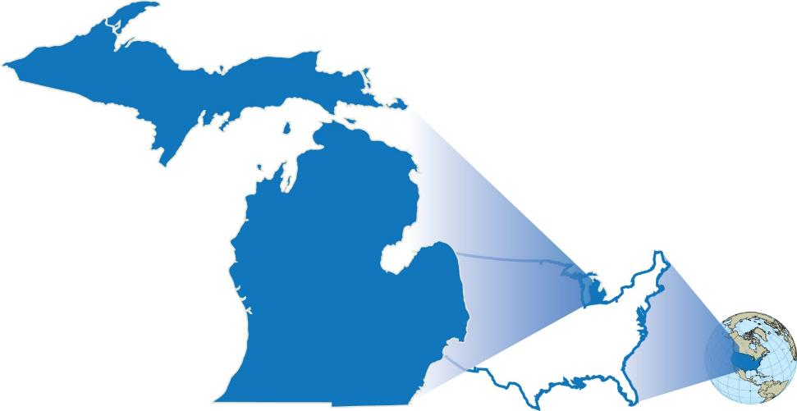
Investment in Michigan and Nation
Best-value procurement approach required by federal regulations
Michigan has proven to be great resource
$944M in procurements and labor spent and obligated since January 2011, $691M (73%) in Michigan (as of 28 February 2018)
FRIB and NSCL Spending since 2011
Michigan
$691M (73%)
Other States
$192M (20%)
Other Countries
$61M (7%)
Notes:
Updated procurement numbers 4/13/17 –LS
Updated procurement numbers 5/22/17-CB
No Updates 7/7/17 - CB
Procurement numbers updated 8/8/17 – CB
Changed 2009 to October 2008 and updated procurement numbers– 10/23/17 – CB
Updated procurement numbers and date 1/15/18 – CB
No changes 1/24/18 – CB
Updated procurement numbers 3/21/18 –WW

Slide 14
Working with the Best in the U.S. and World 13 Active Work-for-Others Agreements and 14 Active MOUs
Argonne National Laboratory (3+1*)
Liquid lithium charge stripper; Stopping of ions in gas; fragment separator design; beam dynamics; SRF
Brookhaven National Laboratory (3)
Radiation resistant magnets; plasma charge stripper*
Fermilab (1)
Diagnostics
Jefferson Laboratory (4)
Cryogenics; SRF
Lawrence Berkeley National Laboratory (2*)
ECR ion source; beam dynamics*
Oak Ridge National Laboratory (2)
Target facility; beam dump R&D
Stanford National Accelerator Lab. (2*)
SRF multipacting*
Budker Inst. of Nuclear Physics (Russia)
Production target
GANIL (France)
Production target
GSI (Germany)
Production target
Legnaro (Italy)
SRF
RIKEN (Japan)
Charge strippers
Sandia
Production target*
Soreq (Israel)
Production target*
TRIUMF (Canada)
SRF
* complete

Slide 15
Summary
FRIB is a game changer for nuclear science
World’s most powerful rare isotope research facility
Users are engaged and ready for science
FRIB is managed well and transparently
FRIB gets excellent reviews from DOE-SC
Good relations with MSU, DOE-SC, State of Michigan, and region
Externally registered ISO 9001, 14001 and OHSAS 18001 management programs
Project is on schedule and on budget, 84% complete
Civil construction started in March 2014, beneficial occupancy reached in March 2017
Technical construction started in October 2014, progressing ahead of baseline schedule
Managing to early completion in 2021
CD-4 (project completion) is June 2022
FRIB will benefit the nation, Michigan, and MSU
Educating next-generation scientists and engineers, addressing workforce needs
Outreach programs and collaborations
Job creation, technology transfer to industry
Knowledge economy jobs and talent in the future
Notes:
No updates 7/7/17 – CB
No changes 1/24/18 – CB

