Slide 1
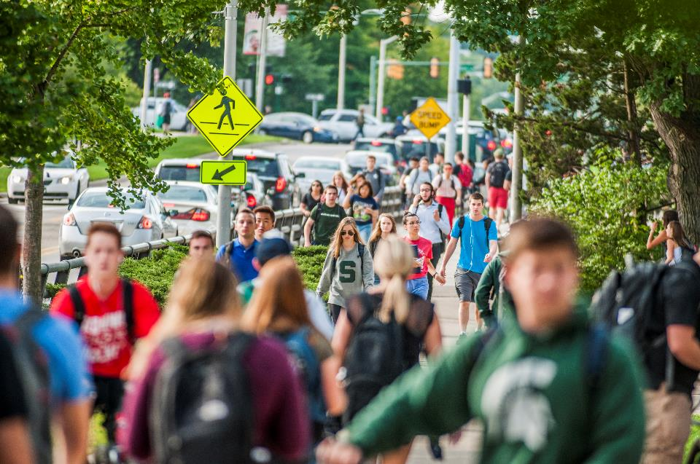
Campus Mobility Plan
Improved Campus Mobility
and
Student Success

Slide 2
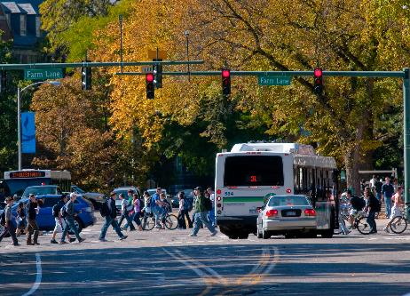
A Quick Recap – Mobility Survey
July 2017
2,571 out of ~11,000 MSU faculty and staff on EL campus responded
Congestion Contributions
89% drive a personal vehicle to work
More respondents move cars for meetings than for lunch
Course scheduling configurations
Predominance of 8-5 work schedule
Supervisors not already granting flex-time are perceived as being unsupportive of potentially granting flex-time
A culture change related to longstanding practices and perceptions of course scheduling, attending meetings, and work schedules is needed

Slide 3
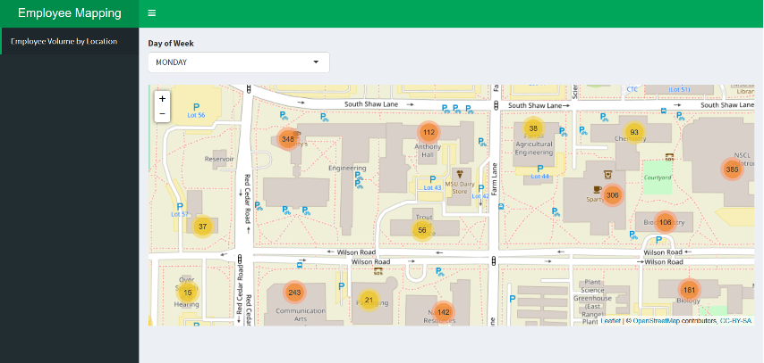
A Quick Recap - Video Conference Locations
Utilization of Data to map MSU Employee locations for potential consideration of dedicated virtual meeting spaces.
IT Services

Slide 4
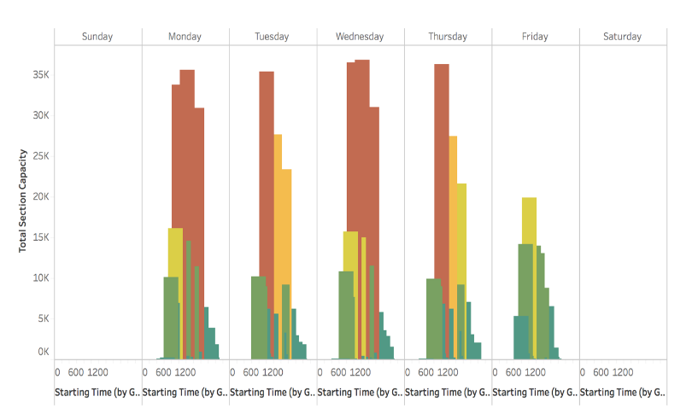
A Quick Recap - Course Scheduling
An overwhelmingly large number of courses are scheduled to start between the hours of 10:20 a.m. and 3:00 p.m., especially on Mondays and Wednesdays
72% of scheduled seats in Fall 2017 were in classes that began within this five-hour window
Institutional Studies, Office of Planning and Budgets

Slide 5
A Quick Recap - Mobility Issues Relevant to Student Success Efforts
The Go Green, Go 15 effort revealed the difficulties many students had in arranging workable schedules.
Distributing classes more broadly throughout the day and week will improve a student’s ability to scheduled classes they need and decrease campus congestion.
Improve a student’s ability to schedule courses closer to one another, alleviating the need for them to leave and return to campus.

Slide 6
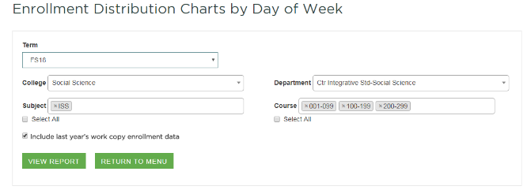
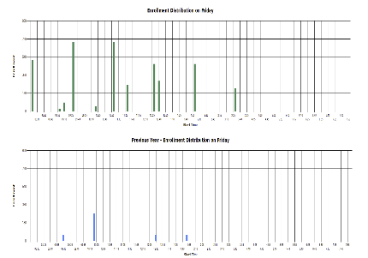
Course Scheduling Efforts
Colleges encouraged to distribute their courses (especially at the 100- and 200-level) throughout the week and across a larger portion of the day.
New 3-day (M-W-F) 4-credit course scheduling option made available.
New visualization tool added to course scheduling system to show capacity across each day/hour including this year/last year comparison.
Office of the Registrar

Slide 7
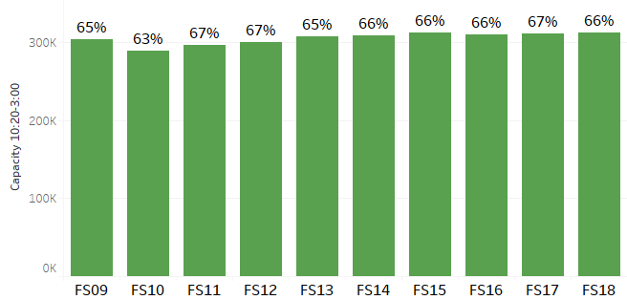
University Capacity – All Courses 10:20-3:00 Start-Time
Fall Terms
% of Total Meeting Time Capacity

Slide 8
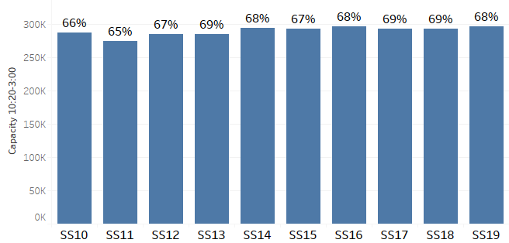
University Capacity – All Courses 10:20-3:00 Start-Time
Spring Terms
% of Total Meeting Time Capacity

Slide 9
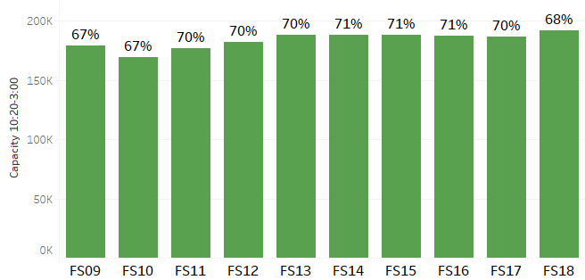
University Capacity – 100-200 Level Courses 10:20-3:00 Start-Time
Fall Terms
% of Total 100-200 Level Meeting Time Capacity

Slide 10
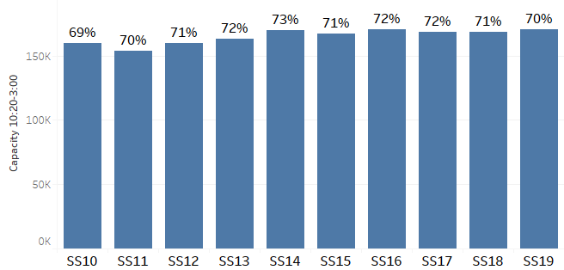
University Capacity – 100-200 Level Courses 10:20-3:00 Start-Time
Spring Terms
% of Total 100-200 Level Meeting Time Capacity

Slide 11
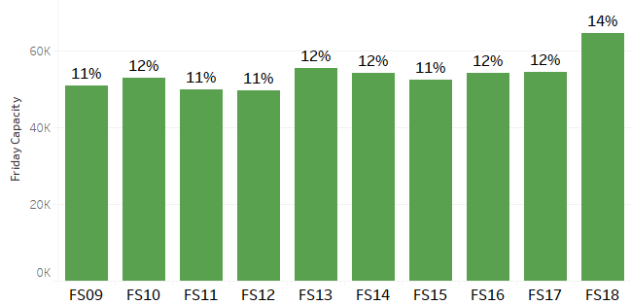
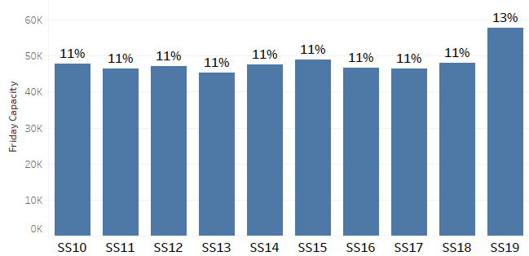
University Capacity – Friday Meeting Times
Fall Terms
% of Total Meeting Time Capacity
Spring Terms
% of Total Meeting Time Capacity

Slide 12
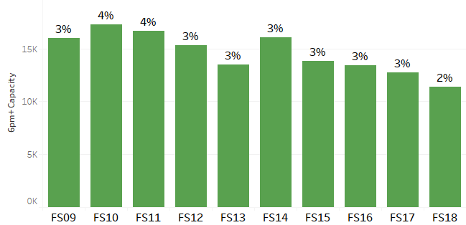
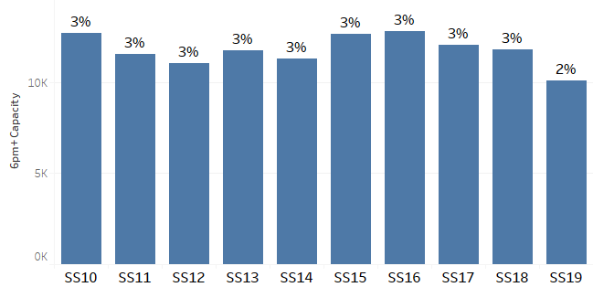
University Capacity – Evening Meeting Times (6pm and after)
Fall Terms
% of Total Meeting Time Capacity
Spring Terms
% of Total Meeting Time Capacity

Slide 13
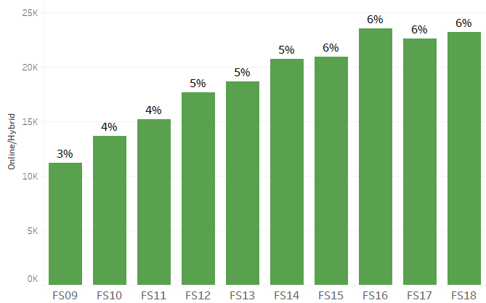
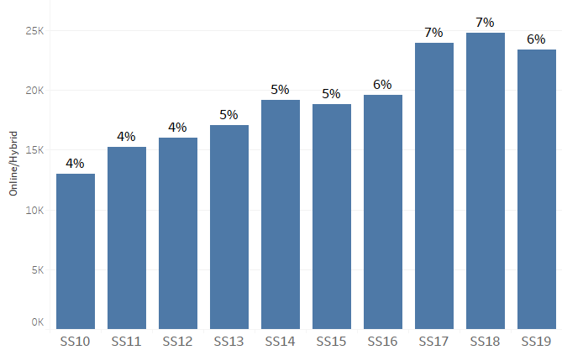
University Capacity – Online/Hybrid
Fall Terms
% of Total Capacity
Spring Terms
% of Total Capacity

Slide 14
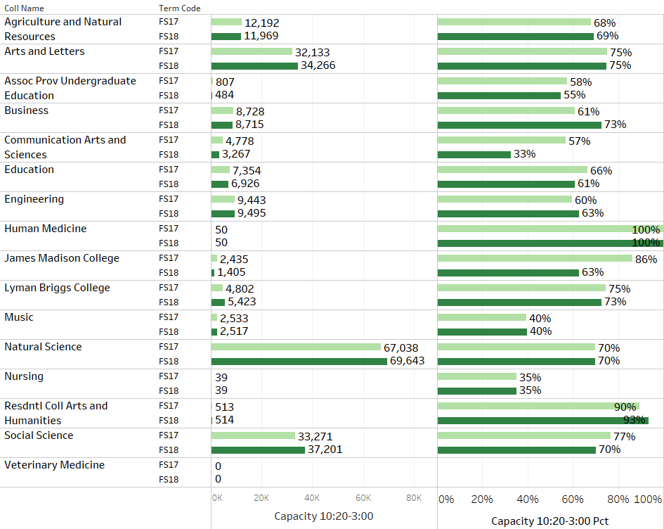
College Capacity
100-200 Level Courses
10:20-3:00 Start-Time FS17 vs FS18

Slide 15
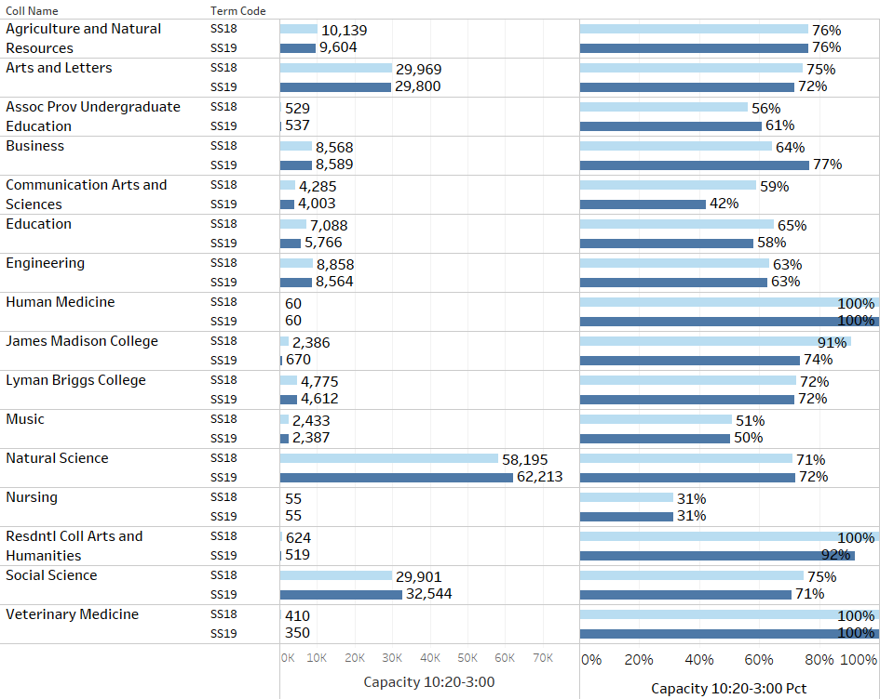
College Capacity
100-200 Level Courses
10:20-3:00 Start-Time SS18 vs SS19

Slide 16
Phase II - Action Plan
Increase our engagement with colleges and departments…
Continue to encourage distribution of classes more broadly throughout the day and week
Proactively encourage more evening offerings
Provide reports that highlight specific 10:20-3:00 Start-Time, Friday, Online/Hybrid, and Evening capacity trends for Departments and Programs

